Slide 1
Code Readability
Code = for humans
Compiled code = for computers
Natural Language conventions work well for humans
In particular: saying something in a verbose/unusual way carries implied meaning
Ex: you'll vs you will
x = x + 1 vs x++

Slide 2
Java Conventions: Collections
Java Collections:
List/ArrayList
Set/HashSet
Map/HashMap
[] arrays are unusual in practice
typically only if you're doing memory management performance optimizations

Slide 3
Java Conventions: Iteration
Iteration over a List/Set/Collection/Iterable:
Old:
List<String> list = new ArrayList<>();
for (int i = 0; i < list.size(); i++) {
String s = list.get(i);
System.out.println(s);
}

Slide 4
Java Conventions: Iteration
Iteration over a List/Set/Collection/Iterable:
New:
List<String> list = new ArrayList<>();
for (String s : list) {
System.out.println(s);
}

Slide 5
Java Conventions: Function Pointers
Instead of parameterizing a type, allows parameterizing behavior
Ex: sorting objects needs a Comparator
How to pass this to a method?
Everything is an Object
Create an interface with the necessary method signature
Pass an implementation of the interface

Slide 6
Java Conventions: Function Pointers
Problem: Creating a whole class just to sort one list is clunky
Solution:
Anonymous inner classes
List<String> strings = new ArrayList<String>();
Collections.sort(strings, new Comparator<String>() {
@Override
public int compare(String s1, String s2) {
// reverse the standard order
return -1*s1.compareTo(s2);
}
});

Slide 7
Java Conventions: Function Pointers
Problem: Anonymous inner classes are clunky
Solution: Lambdas (introduced in Java 8)
List<String> strings = new ArrayList<String>();
Collections.sort(strings, (s1, s2) -> -1*s1.compareTo(s2));

Slide 8
Java Conventions: Function Pointers
Problem: Lambdas remove too much info
Solution: More than 1 lambda in a scope → create named, typed variables for them
List<String> strings = new ArrayList<String>();
Comparator<String> reverseSort = (s1, s2) -> -1*s1.compareTo(s2);
Collections.sort(strings, reverseSort);

Slide 9
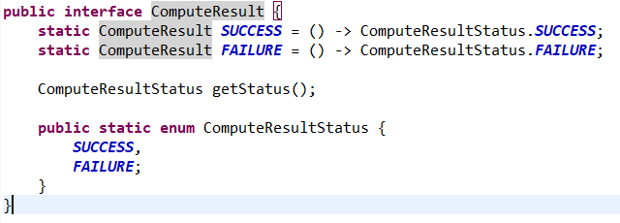
Lambdas as Constants
Combined with static constants on interfaces, you can easily and compactly return values without losing API flexibility.

Slide 10
Java Conventions: Fluent Interfaces
Often combined with lambdas
Allows chaining method calls, by calling a method on the returned object
Without fluent interface:
public static void main(String[] args) {
Widget w = new Widget();
w.addGearToWidget();
w.addCrankToWidget();
}
public static class Widget {
public void addGearToWidget() {/* do things */}
public void addCrankToWidget() {/* do things */}
}

Slide 11
Java Conventions: Fluent Interfaces
Often combined with lambdas
Allows chaining method calls, by calling a method on the returned object
With fluent interface:
public static void main(String[] args) {
Widget w = new Widget()
.addGearToWidget()
.addCrankToWidget();
}
public static class Widget {
public Widget addGearToWidget() {/* do things */ return this;}
public Widget addCrankToWidget() {/* do things */ return this;}
}

Slide 12

Design Patterns
Many problems have a common structure
Design patterns are like a toolbox to help solve common problems
For each pattern:
Know what type of problem to apply it to
Know how to adapt the pattern to the problem
Recognize complex uses of the pattern
We'll be covering some common ones, there are many more (https://refactoring.guru/design-patterns has a good list)

Slide 13
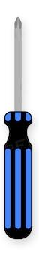

Design Patterns
When should you use a design pattern?
Usually, when you have no other choice
Tools, not building blocks - don't go looking for ways to use them, let the problems come to you

Slide 14

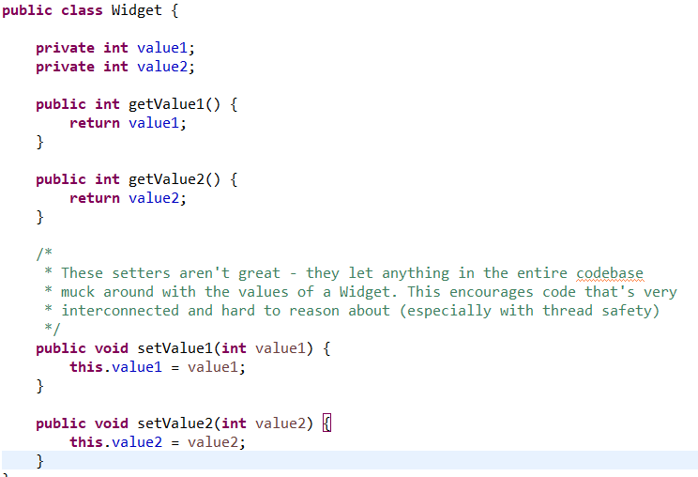
Design Patterns
Builder Pattern (related: Factory pattern)
Problem: Some object that will be widely passed around can't easily be constructed all at once with a constructor.
How to avoid having mutable state all over the codebase?

Slide 15
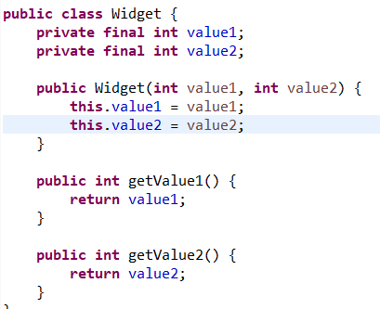
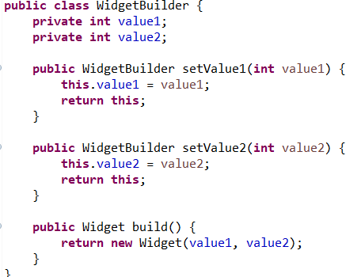
Design Patterns
Builder Pattern (related: Factory pattern)
Solution: Create a helper class that handles construction; the resulting object is immutable, while the helper class (WidgetBuilder/WidgetFactory) contains the mutable data
Note the return values - this is a fluent interface, meaning the code that uses it has easily-readable chained calls:
new WidgetBuilder()
.setValue1(1)
.setValue2(2)
.build()

Slide 16
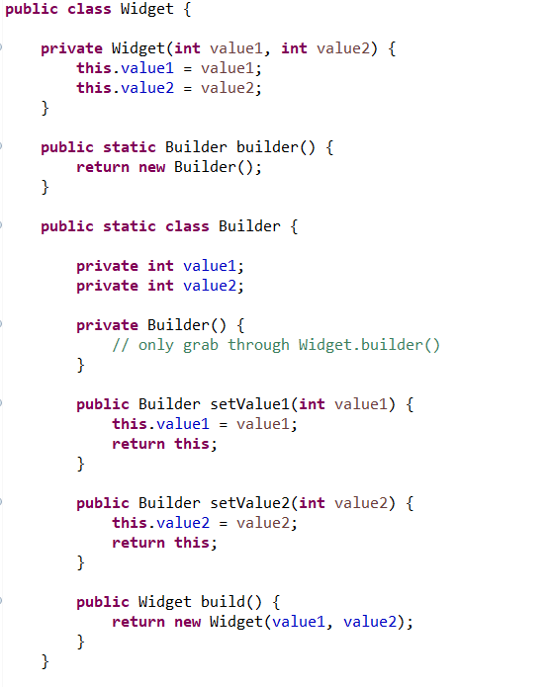
Design Patterns
Builder Pattern (related: Factory pattern)
Fancy Solution: Make the helper class a static inner class
Caller:
Widget.builder()
.setValue1(1)
.setValue2(2)
.build()
Extra bonus: with overloaded constructors, there’s no way to make both value1 and value2 independently options, since they’re both ints. With builders, you can!

Slide 17
Your Turn!
Follow the link from Brightspace to check out the CodingExercises repo; use ./gradlew eclipse to set up a project to import into your IDE
If you need to update your JUnit version, do that before running gradlew eclipse
In exercise1, use the Builder pattern to fix the TODO in Train.java; when you're done, you should have two different classes, and the TrainTest should no longer compile

Slide 18
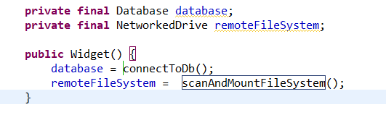
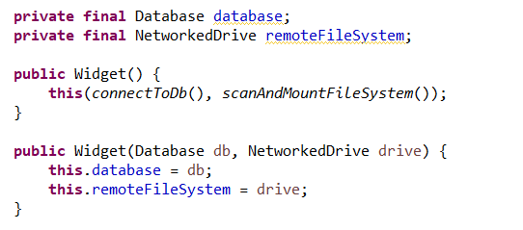
Design Patterns
Dependency Injection
Problem: Component1 depends on Component2 and Component3, and is set up to connect to/create them in the constructor.
How do I unit test this code?
Solution: Force the constructor to take in an already-build Component2 and Component3, and move the connection/creation logic elsewhere
Fun fact: Using TDD (test-driven development) forces you to set everything up this way from the beginning

Slide 19
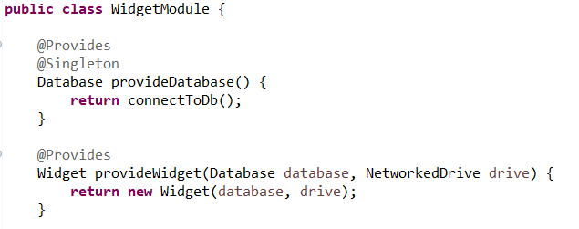
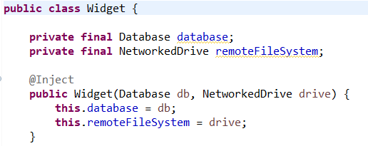
Design Patterns
Dependency Injection (part 2)
Problem: 3 different components all use the same (expensive-to-build) sub-component.
How do I get them to share an instance?
Solution:
Use a dependency injection library: Guice, Dagger
Good to recognize, since codebases using an annotation framework never explicitly call a constructor, which can be confusing to see

Slide 20
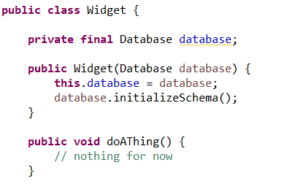
Design Patterns
Lazy Initialization
Problem: Some object relies on an expensive computation to be able to work properly
How to prevent this slowing down server/process/component startup?

Slide 21
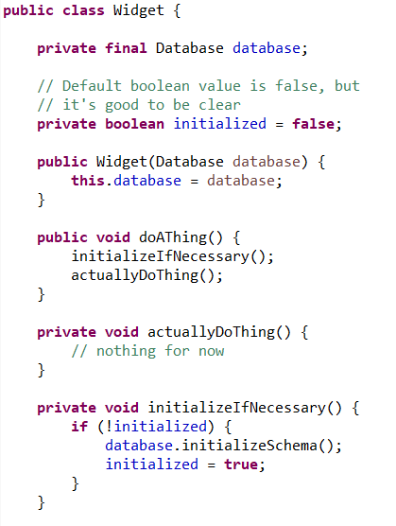

Design Patterns
Lazy Initialization
Solution: initialize on demand
Bonus: May never need to initialize
This is fragile, so only use if needed, and make sure to test!
Ex: what happens if initializeSchema() fails?

Slide 22
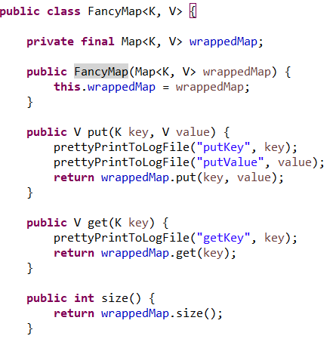
Design Patterns
Wrapper/Decorator
Problem: I have a complicated object, and I want to add a small amount of functionality to it
How can I easily augment every method of a class?

Slide 23
Design Patterns
Wrapper/Decorator
Why not just extend a class?

Slide 24
Design Patterns
Wrapper/Decorator
Why not just extend a class?
This is more flexible!
Accepts any implementation of an interface
Can be nested with other wrappers (if combined with implementing the interface itself)
Can limit the methods of the wrapped object (if needed)

Slide 25
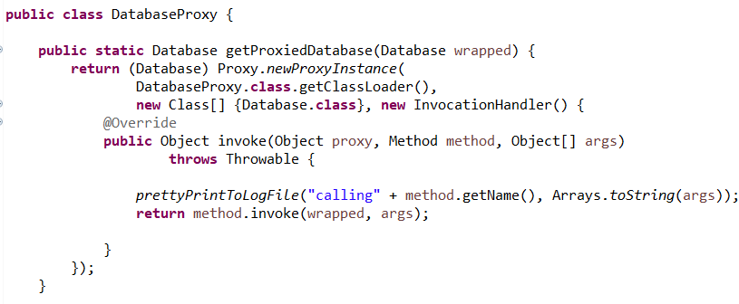
Design Patterns
Advantage: automatically updates as the class/interface changes (reduces maintenance burden).
Often used for security checks or logging frameworks
Wrapper/Decorator Xtreme: Proxy
Hidden by the classloader
Doesn't change the type of the object

Slide 26
Your Turn!
Use the starter code in the exercise2 package
Use the Wrapper pattern to create an Animal implementation that stops you from trying to pet an unfriendly animal
Use the wrapper you created to add some safety precautions to the PettingZoo - when you’re done, the PettingZooTest should pass

Slide 27
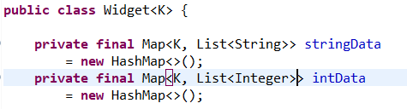
Design Patterns
Visitor
Problem: I have a collection of related objects of different types, and I want users to be able to interact with the collection seamlessly
Normally, I'd use an iterator, but the types are all wrong!
How can I make 'choose how to interact with an object' part of my API?

Slide 28
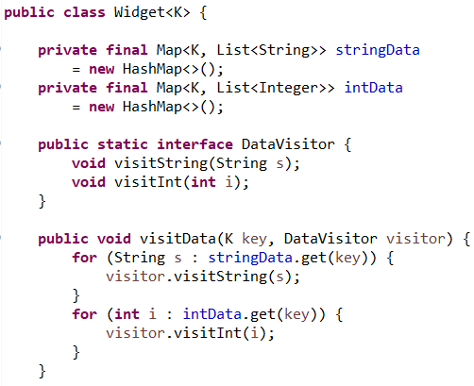
Design Patterns
Visitor
Solution: Give users a structured way to specify per-type behavior
If types change over time, much easier to find and fix problems vs an iterator with instanceof/type casts
Easier to implement as a user (what types are present is enforced by compiler)

Slide 29
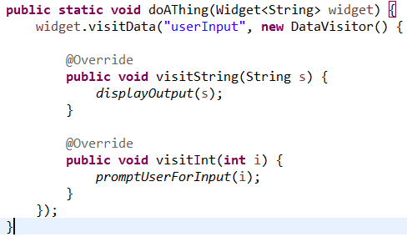
Design Patterns
Visitor
Solution: Give users a structured way to specify per-type behavior
If types change over time, much easier to find and fix problems vs an iterator with instanceof/type casts
Easier to implement as a user (what types are present is enforced by compiler)

Slide 30
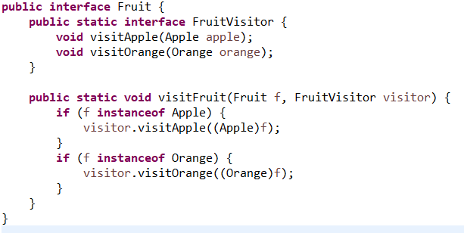
Design Patterns
Visitor
Additional use: structured type casting
If you have an interface where you need a compile-time check of the types of things that implement it (say, hypothetically, an InputConfiguration), visitors let you enforce that

Slide 31
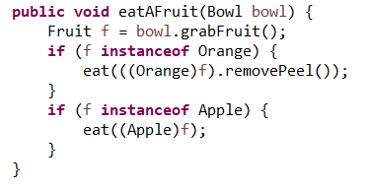
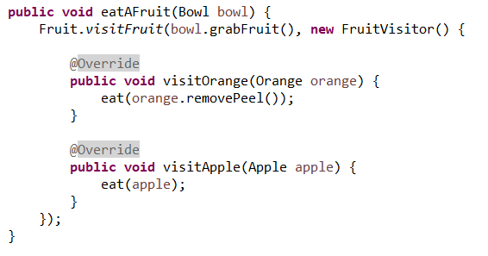
Design Patterns
Visitor
Additional use: structured type casting
If you have an interface where you need a compile-time check of the types of things that implement it (say, hypothetically, an InputConfiguration), visitors let you enforce that

Slide 32
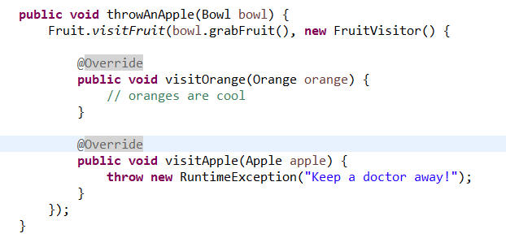
Design Patterns
Visitor
Additional use: structured type casting
If you have an interface where you need a compile-time check of the types of things that implement it (say, hypothetically, an InputConfiguration), visitors let you enforce that

Slide 33
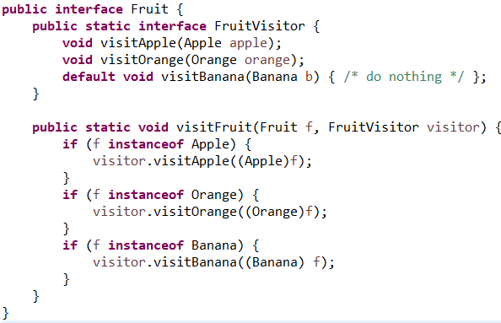
Design Patterns
Visitor
What happens if we add Bananas?
Update FruitVisitor to have visitBanana()
Option 1: Include a default no-op Banana behavior (backwards-compatible)
Option 2: Compiler will find you every place that needs to be updated (guaranteed)

Slide 34
Design Patterns
public interface Fruit {
public void accept(FruitVisitor visitor);
public static interface FruitVisitor {
void visitApple(Apple apple);
void visitOrange(Orange orange);
}
}
Visitor (Alternate)
Is there any way to get rid of those instanceof checks entirely?
⇒ Have the fruit itself handle the type checking
But:
the downside in terms of readability means in practice this is not a good option (breaks OOP best practices with inversion of control)
still have to exhaustively list all types in the Visitor definition
⇒ Good to recognize, not to use
Best practices constantly evolve depending on what works in practice - this was a good idea that didn’t turn out to work well
public class Apple implements Fruit {
@Override
public void accept(Fruit.FruitVisitor visitor) {
visitor.visitApple(this);
}
}
public void eatAFruit(Bowl bowl) {
bowl.grabFruit().accept(new FruitVisitor() {
@Override
public void visitApple(Apple apple) {
eat(apple);
}
@Override
public void visitOrange(Orange orange) {
eat(orange.removePeel());
}
});
}

Slide 35
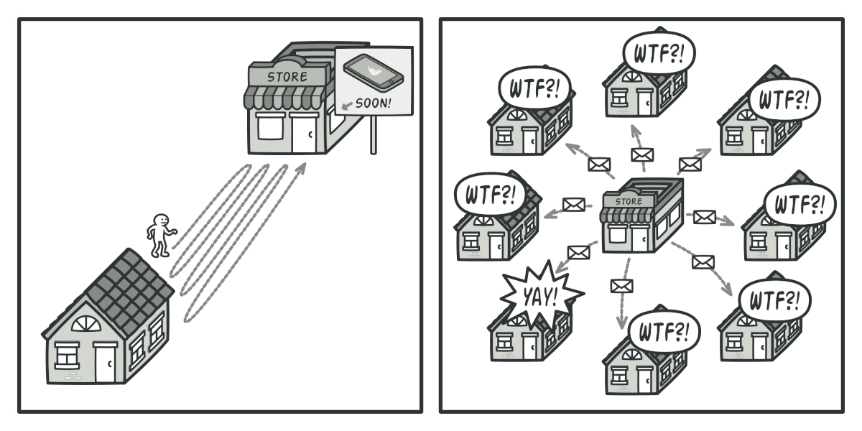
Design Patterns
Listener/Subscriber
Problem: When some data changes, I want to tell any other pieces of code that might be interested, but I don't know what they all are up front.
How can I introduce runtime connections between components tied to changing data?

Slide 36
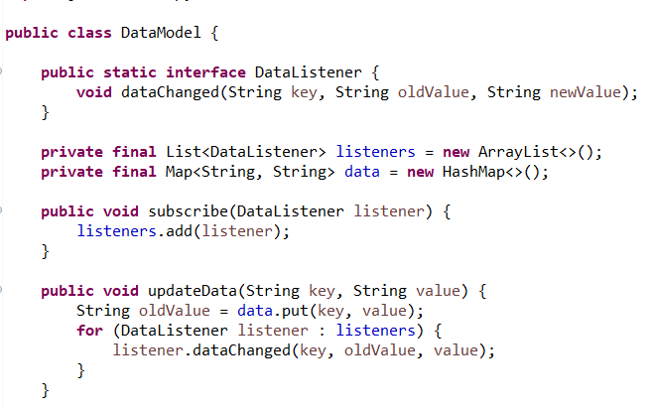
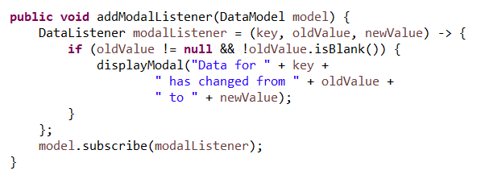
Design Patterns
Listener/Subscriber
Solution: A component can subscribe to a particular set of changes

Slide 37
Design Patterns
Listener/Subscriber
When to use listener/subscriber vs. having 'on data changed' logic in the data class:
Generic data classes
Many different behaviors for listeners

Slide 38
Your Turn!
Start with the code in the exercise3 package
Use the Listener pattern to fix the TODOs in StudentDirectory, CSDepartment, and ITDepartment

Slide 39
Coding Concept Patterns
Somewhere between a "best practice" and a "design pattern"
Still matches a problem to a solution, but in a more abstract way than design patterns

Slide 40
Resilient Code
Goes by many names (code path/execution isolation, defensive coding, etc)
Goal: If Component A has a bug/becomes malicious, Component B should still work
Solutions:
Sanitize/validate inputs for public methods and constructors
Isolate method calls by default (clients must pass a key or some other info to connect different calls)
Methods can be called in any order (hide implementation details behind wrapper methods)

Slide 41
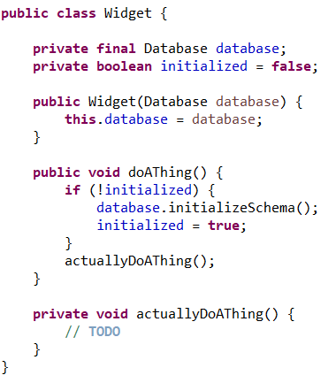
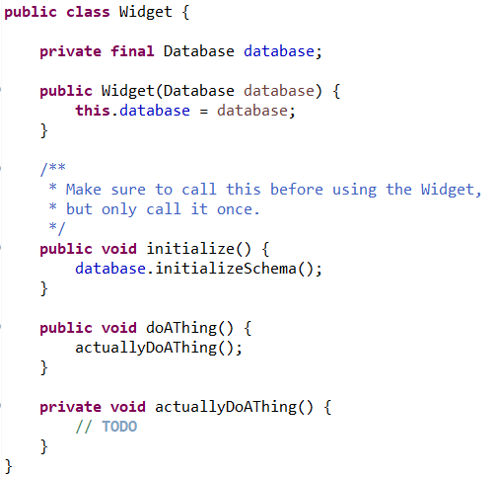
Resilient Code
Good: Fragile:

Slide 42
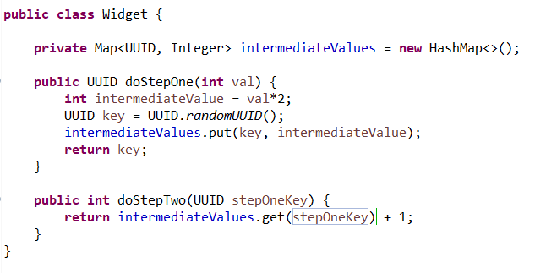
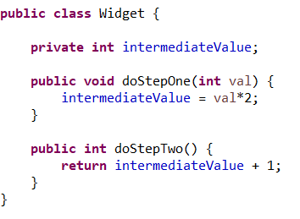
Resilient Code
Good: Fragile:

Slide 43
Stateless Services
Goal: Prevent multiple callers of a method/clients of a server from messing with each other
Solution:
Move state management from implementation to client

Slide 44
Stateless Services
Adding multiple clients is risky/difficult:
public static interface Server {
public void initializeWorkflow(String startingData);
public void runWorkflow();
public String getResultsOfWorkflow();
}
public void client(Server server) {
server.initializeWorkflow("Hello World");
server.runWorkflow();
String result = server.getResultsOfWorkflow();
}
⇒ Use parameters/return values to track client-related state; implementation should only store client-independent state
Adding multiple clients is easy:
public static interface Server {
public String runWorkflow(String startingData);
}
public void client(Server server) {
String result = server.runWorkflow("Hello World");
}

Slide 45
Streaming Inputs/Outputs
Large (or potentially large) inputs
Doesn't fit in memory
Fits in memory, but it's slow
Usually fits in memory, but sometimes…
Inputs without a known-beforehand end point
Files
Network socket inputs
Running a 'where' query on a database table

Slide 46
Streaming Solutions
Iterable<T>/Iterator<T>
Most general/flexible
Iterable is nicer than iterator (can be used in for loops), but requires that the input can be restarted
Typically used when the entire stream needs to be read

Slide 47
Streaming Solutions
Stream<T>
Introduced in Java 8
Rarely explicitly instantiated
Good for pipelining operations
Can become unreadable quickly, be careful about making your pipeline too dense!
map means 'transform'

Slide 48
Streaming Solutions
Good example of how lambdas can become too dense - remember to turn lambdas into their own named variables when there is more than 1
What even is this:
new ArrayList<String>().stream()
.filter(s -> s.indexOf(" ") == -1)
.map(s -> s.toUpperCase())
.distinct()
.flatMapToInt(s -> s.chars());
Better:
new ArrayList<String>().stream()
.filter(removeStringsWithSpaces)
.map(toUpperCase)
.distinct()
.flatMapToInt(addAsciiValueOfCharacters);

Slide 49
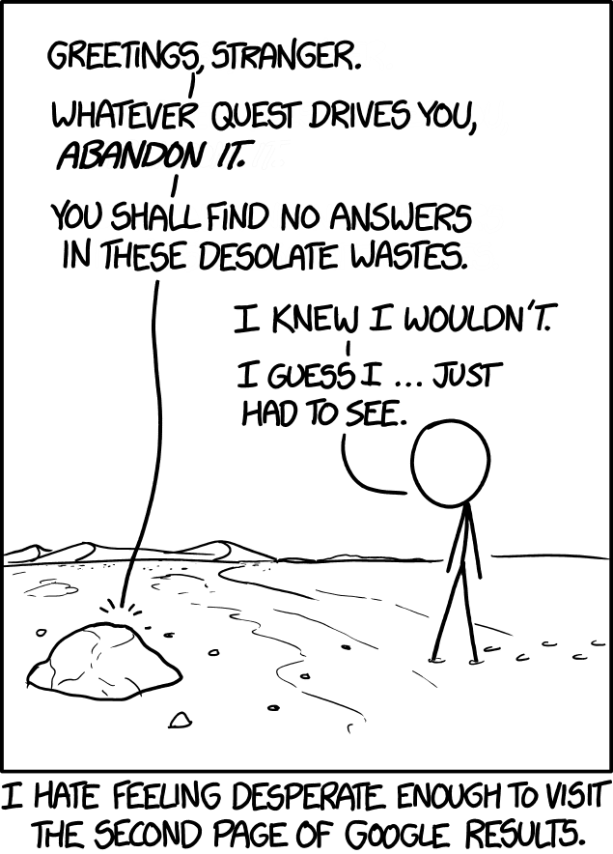
Streaming Inputs/Outputs
Paging: define a page size and a hasMore flag
Good for situations where only some of the input is needed
Choose the page size to fit nicely in memory
(typically a List<T>)
Allows batching of downstream processing (ex: printing)
Can include the number of pages, or (more common) an approximate number of pages
Tricky bit: getNextPage
Deterministic ordering, O(n²) traversal
Iterator pointer (can get into memory leak situations)

Slide 50
Your Turn!
Start with the code in the exercise4 package
Using an Iterator, change findMaximumValue to accept an arbitrarily large number of input integers

Slide 51
Let's Review!
Code Conventions: Compact iteration, lambdas, generics (syntax)
Design Patterns: Problems/Basic solutions for Builders, Dependency Injection, Lazy Initialization, Wrappers, Visitors, Listeners
Resilient Code: 3 ways to make a component robust to failure in other components
Streaming: When to use Collection vs Iterable vs Iterator vs Paging

